Slide 1
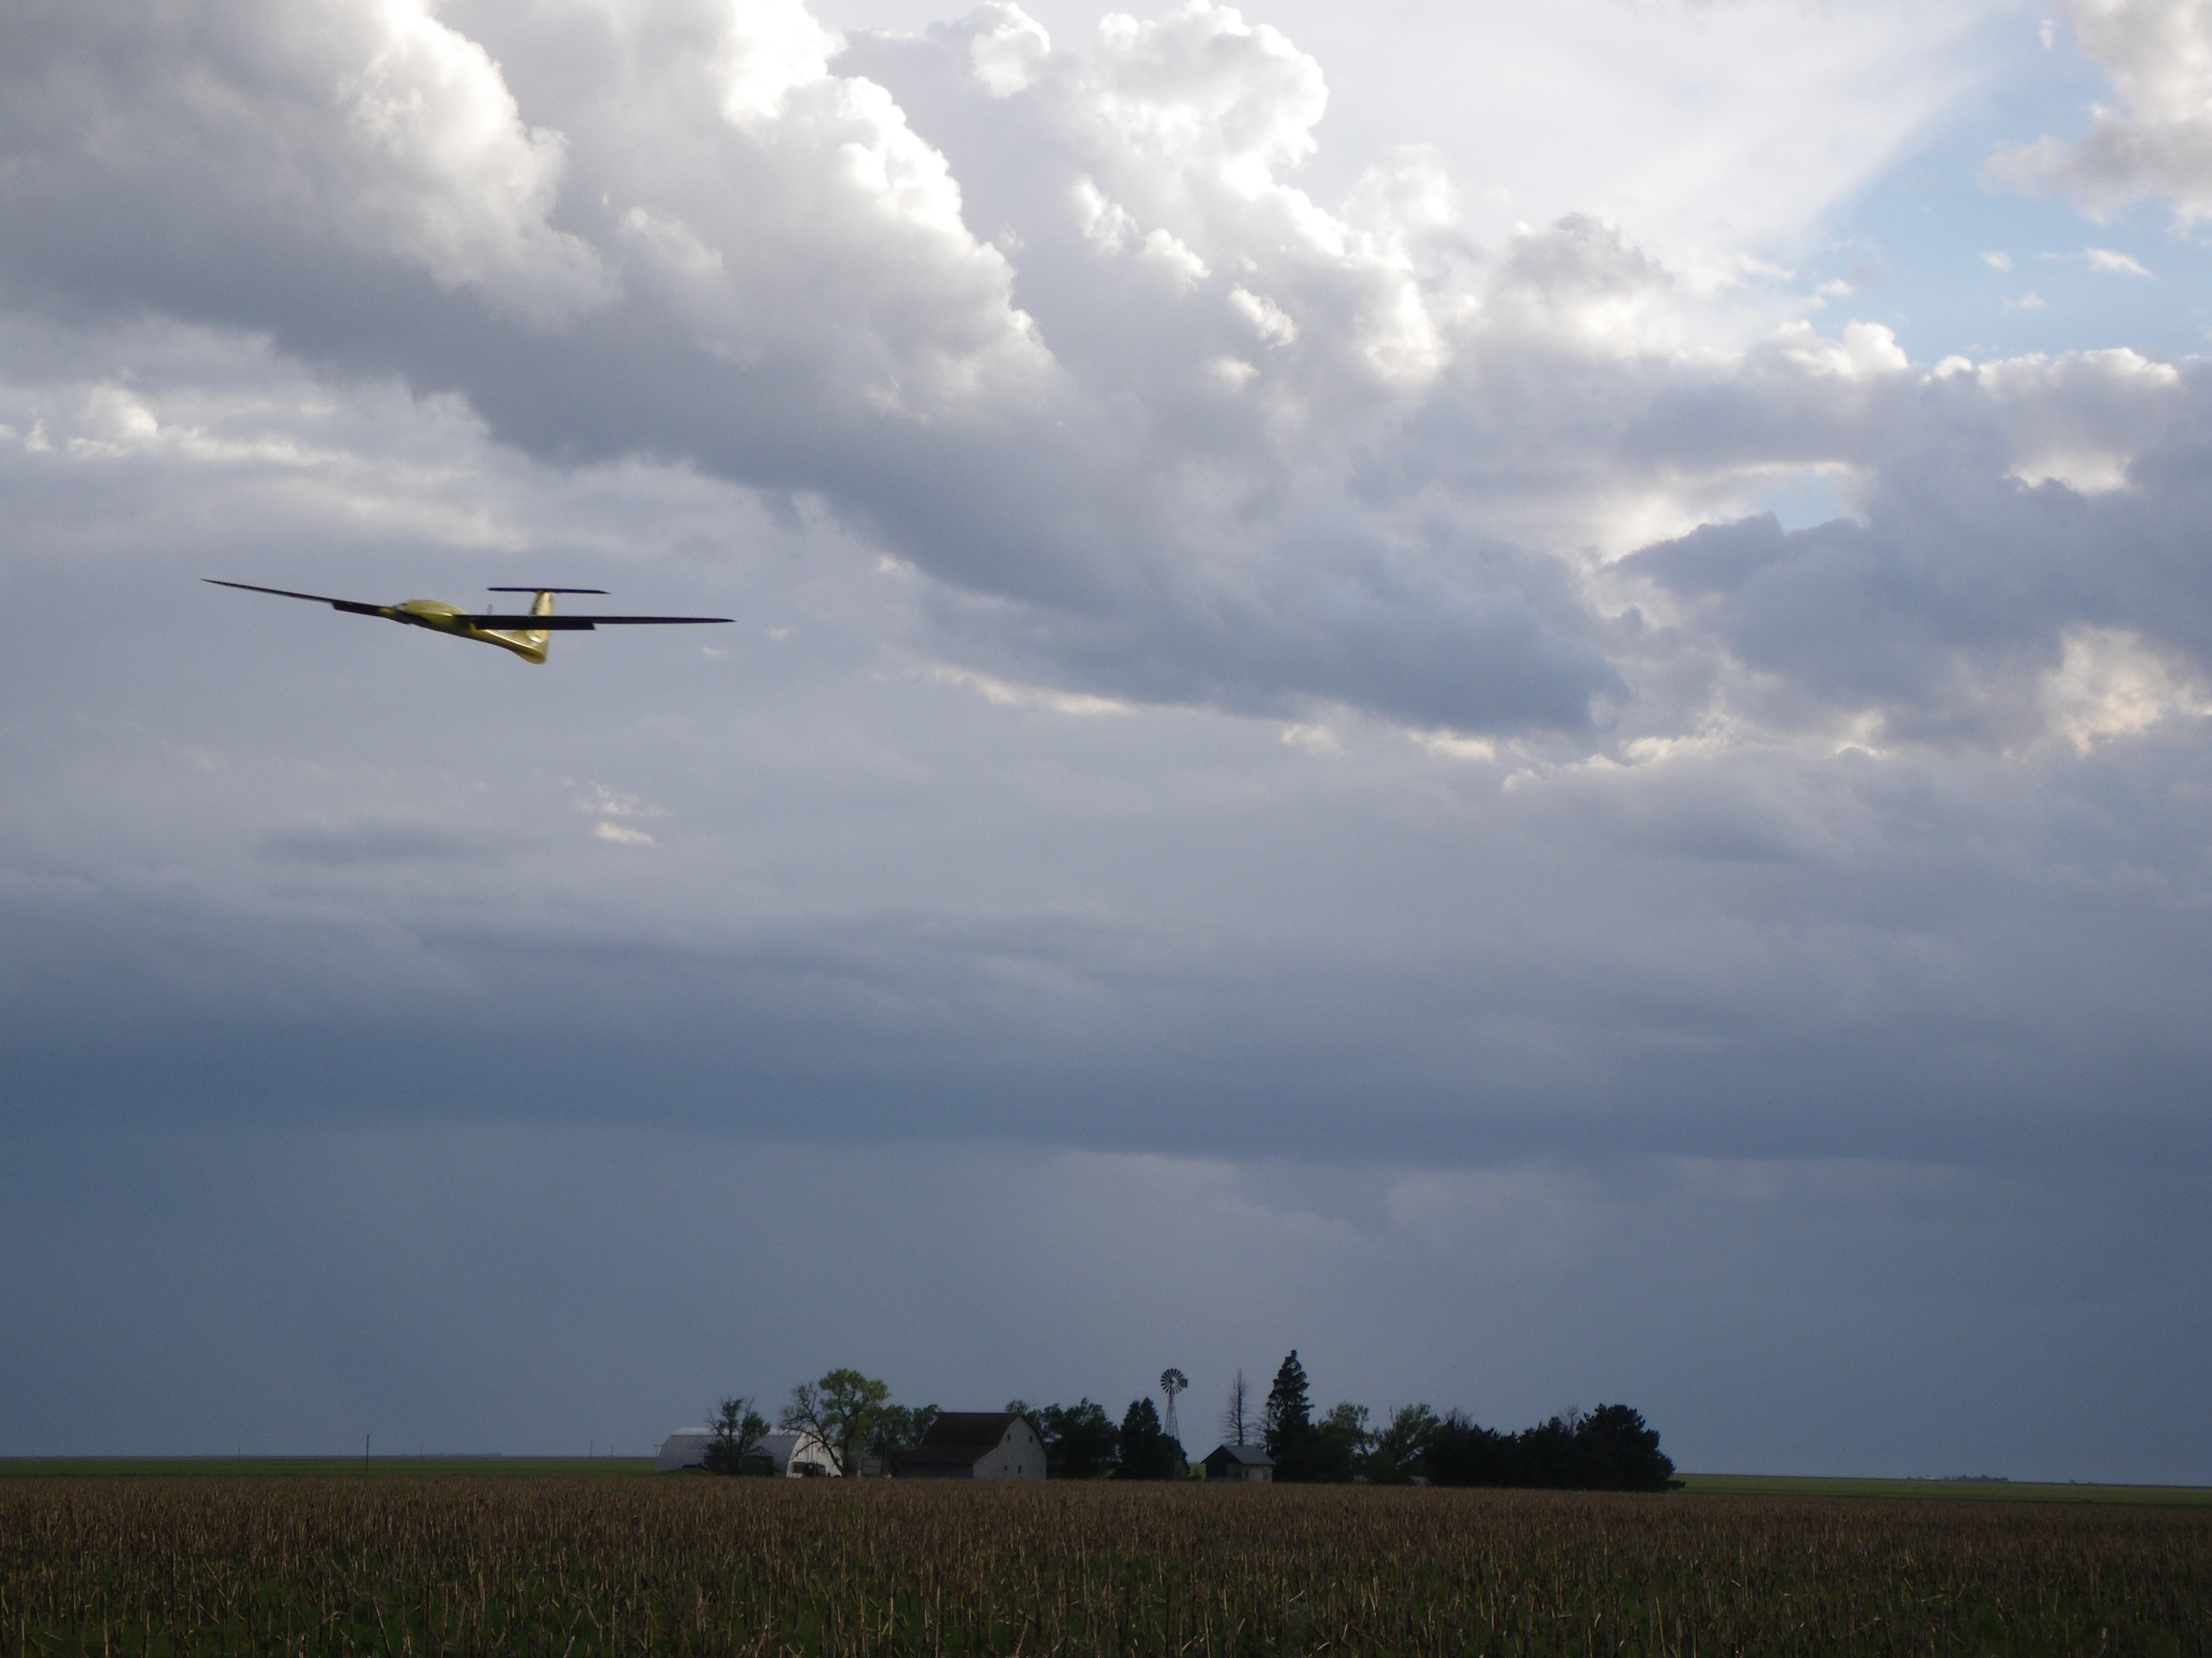
Chapter 6
Successive Loop Closure
TexPoint fonts used in EMF.
Read the TexPoint manual before you delete this box.: AAAAA

Slide 2
Architecture

Slide 3
Outline
Different Options for Autopilot Design
Successive Loop Closure
Total Energy Control
LQR Control

Slide 4
Successive Loop Closure
Open-loop system
Closed-loop system

Slide 5
SLC: Inner Loop Closed
At frequencies below
inner-loop bandwidth,
approximate CLTF as 1,
then design middle loop

Slide 6
SLC: Two Loops Closed
At frequencies below
middle-loop bandwidth,
approximate CLTF as 1,
then design outer loop
Key idea: Each successive loop must be lower in bandwidth --- typically by a factor of 10 or more

Slide 7

Lateral-directional Autopilot
Course Control
Roll Control
Yaw Damper

Slide 8
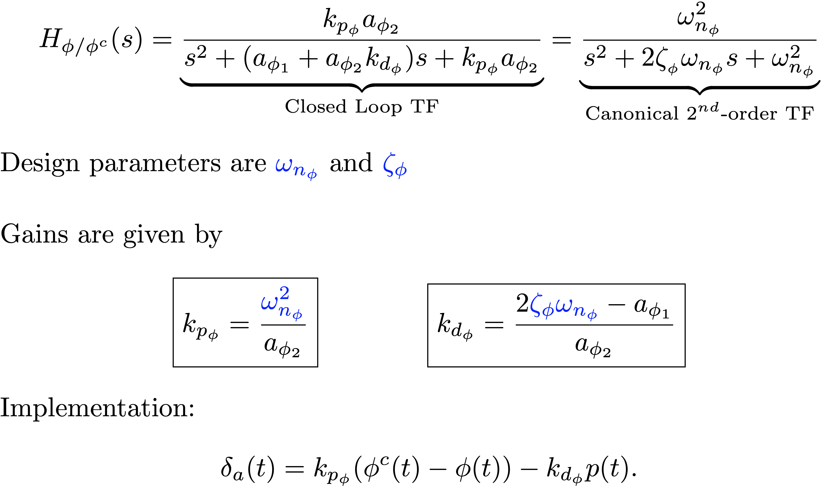
Roll Autopilot
Notes:
\[
H_{\phi/\phi^c}(s) = \underbrace{\frac{k_{p_{\phi}}a_{\phi_2}}{s^2 + (a_{\phi_1}
+ a_{\phi_2}k_{d_{\phi}})s + k_{p_{\phi}}a_{\phi_2}}}_{\text{Closed Loop TF}}
= \underbrace{\frac{\omega_{n_\phi}^2}{s^2 + 2\zeta_{_\phi}\omega_{n_\phi} s +
\omega_{n_\phi}^2}}_{\text{Canonical $2^{nd}$-order TF}}
\]
Design parameters are {\color{blue}$\omega_{n_\phi}$} and {\color{blue}$\zeta_{\phi}$}
\vspace{.5cm}
Gains are given by
\[
\boxed{k_{p_\phi} = \frac{{\color{blue}\omega_{n_\phi}^2}}{a_{\phi_2}}}\qquad \qquad
\boxed{k_{d_{\phi}} = \frac{2{\color{blue}\zeta_{\phi}}{\color{blue}\omega_{n_\phi}}-a_{\phi_1}}{a_{\phi_2}}}
\]
Implementation:
\[
\delta_a(t) = k_{p_\phi} (\phi^c(t) - \phi(t)) - k_{d_\phi} p(t).
\]

Slide 9
Roll Autopilot
The book suggests using an integrator on roll in the roll loop to correct for any steady-state error due to disturbances
Our current suggestion is to not have an integrator on inner loops, including the roll loop
Integrators add delay and instability -> not a good idea for inner-most loops
An integrator will be used on the course loop to correct for steady-state errors
Notes:
\[
H_{\phi/\phi^c}(s) = \underbrace{\frac{k_{p_{\phi}}a_{\phi_2}}{s^2 + (a_{\phi_1}
+ a_{\phi_2}k_{d_{\phi}})s + k_{p_{\phi}}a_{\phi_2}}}_{\text{Closed Loop TF}}
= \underbrace{\frac{\omega_{n_\phi}^2}{s^2 + 2\zeta_{_\phi}\omega_{n_\phi} s +
\omega_{n_\phi}^2}}_{\text{Canonical $2^{nd}$-order TF}}
\]
Design parameters are {\color{blue}$e_{\phi}^{\max}$} and {\color{blue}$\zeta_{\phi}$}
\vspace{.5cm}
Gains are given by
\[
\boxed{k_{p_\phi} = \frac{\delta_a^\text{max}}{{\color{blue} e_{\phi}^{\max}}}}\qquad \qquad \boxed{k_{d_{\phi}} = \frac{2{\color{blue}\zeta_{\phi}}\omega_{n_\phi}-a_{\phi_1}}{a_{\phi_2}}}
\]

Slide 10
Lateral-directional Autopilot
1

Slide 11
Course Hold Loop
Notes:
\noindent
For the course loop, note the presence of the input disturbance.
\\
\noindent
Using a PI controller for course, the response to the course command and disturbance is given by
\[
\chi = \frac{k_{p_{\chi}} g/V_a s + k_{i_{\chi}}
g/V_a}{s^2 + k_{p_{\chi}} g/V_a s + k_{i_{\chi}} g/V_a} \chi^c
+
\frac{g/V_g s}{s^2 + k_{p_{\chi}} g/V_a s + k_{i_{\chi}}g/V_a} d_{\chi}
\]
\noindent
Note:
\begin{itemize}
\item There is a zero in the response to the course command $\chi^c$.
\item The presence of the zero at the origin ensures rejection of low frequency disturbances.
\end{itemize}

Slide 12
TF Zero Affects Response
Notes:
With a zero, the canonical second-order TF is given by
\[
H = \frac{2\zeta \omega_{n} s +
\omega_{n}^2}{s^2 + 2\zeta\omega_{n} s +
\omega_{n}^2}
\]
Note that $\zeta$ has a different effect when the zero is present

Slide 13
Course Hold Loop
Notes:
\[
\chi = \underbrace{\frac{(k_{p_{\chi}} g/V_g) s + (k_{i_{\chi}}
g/V_g)}{s^2 + (k_{p_{\chi}} g/V_g) s + (k_{i_{\chi}} g/V_g)} \chi^c}_{\text{Response to course command}} +
\underbrace{\frac{(g/V_g) s}{s^2 + (k_{p_{\chi}} g/V_g) s + (k_{i_{\chi}}
g/V_g)} d_{\chi}}_{\text{Response to disturbance}}
\]
Equating coefficients to canonical TF gives:
\[
\omega_{n_\chi}^2 = k_{i_{\chi}}g/V_g \qquad \text{and} \qquad 2\zeta_{_\chi}\omega_{n_\chi} = k_{p_{\chi}}g/V_g
\]
or
\[
\omega_{n_\chi} = \frac{1}{{\color{blue}W_{\chi}}}\omega_{n_\phi} \qquad \qquad
\boxed{k_{p_{\chi}} = 2{\color{blue}\zeta_{_\chi}}\omega_{n_\chi}V_g/g} \qquad \qquad
\boxed{k_{i_{\chi}} = \omega_{n_\chi}^2 V_g/g}
\]
Design parameters are bandwidth separation {\color{blue}$W_{\chi}$} and damping ratio {\color{blue}$\zeta_{\chi}$}

Slide 14
Yaw Damper

Slide 15
Lateral Autopilot - Summary
Notes:
\noindent
If model is known, the the design parameters are
\vspace{0.12in}
\par\noindent{\bf Inner Loop (roll attitude hold)}
\begin{itemize}
\item ${\color{blue}\omega_{n_\phi}}$ - Error in roll when aileron just saturates
\item ${\color{blue}\zeta_{\phi}}$ - Damping ratio for roll attitude loop
\end{itemize}
\par\noindent{\bf Outer Loop (course hold)}
\begin{itemize}
\item ${\color{blue}W_\chi>1}$ - Bandwidth separation between roll and course loops
\item ${\color{blue}\zeta_{\chi}}$ - Damping ratio for course hold loop
\end{itemize}
\par\noindent{\bf Yaw damper (if rudder is available)}
\begin{itemize}
\item ${\color{blue}\tau_r}$ - cut off frequency for wash-out filter
\item ${\color{blue}k_r}$ - gain for yaw damper
\end{itemize}

Slide 16
Lateral Autopilot – In Flight Tuning
Notes:
\noindent
If model is not known, and autopilot must be tuned in flight, then the following gains are tuned one at a time, in this specific order:
\vspace{0.12in}
\par\noindent{\bf Inner Loop (roll attitude hold)}
\begin{itemize}
\item ${\color{blue}k_{d_{\phi}}}$ - Increase $k_{d_{\phi}}$ until onset of instability, and then back off by 20\%
\item ${\color{blue}k_{p_{\phi}}}$ - Tune $k_{p_{\phi}}$ to get acceptable step response
\end{itemize}
\par\noindent{\bf Outer Loop (course hold)}
\begin{itemize}
\item ${\color{blue}k_{p_{\chi}}}$ - Tune $k_{p_{\chi}}$ to get acceptable step response
\item ${\color{blue}k_{i_{\chi}}}$ - Tune $k_{i_{\chi}}$ to remove steady state error
\end{itemize}
\par\noindent{\bf Sideslip hold (if rudder is available)}
\begin{itemize}
\item ${\color{blue}\tau_{r}}$ - Tune $\tau_{r}$ to get acceptable step response
\item ${\color{blue}k_{r}}$ - Tune $k_{r}$ to remove steady state error
\end{itemize}

Slide 17
Longitudinal Flight Regimes
Take-off zone

Slide 18
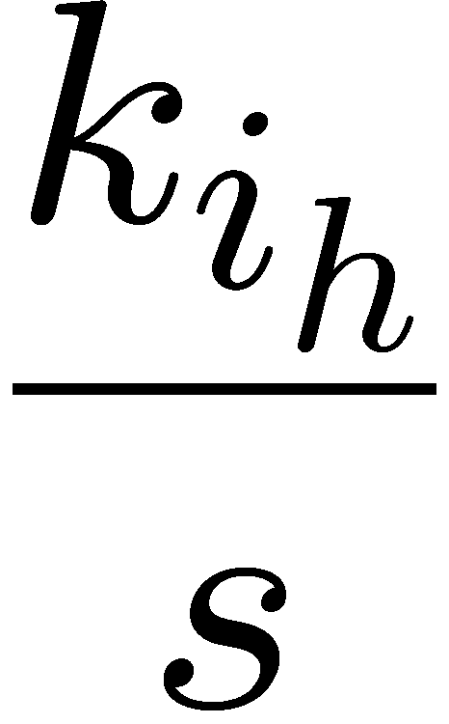
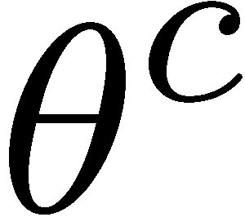
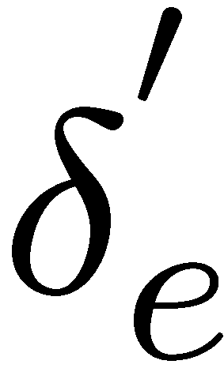
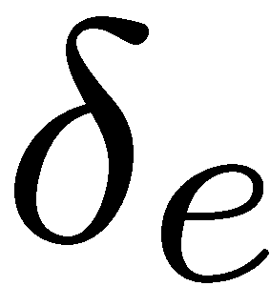
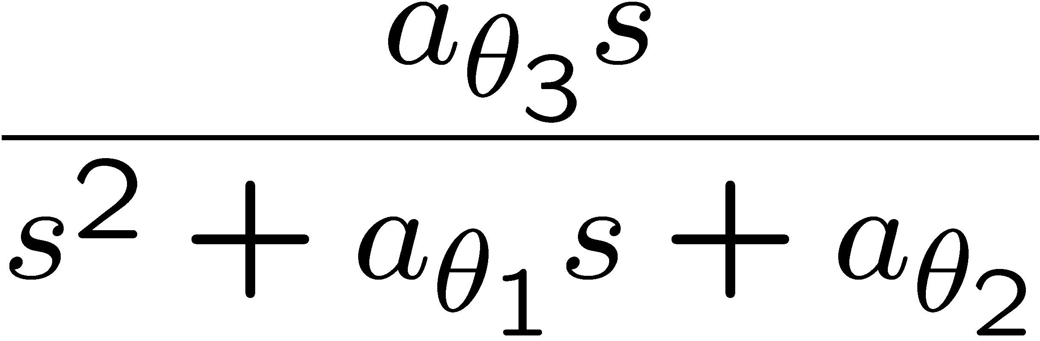


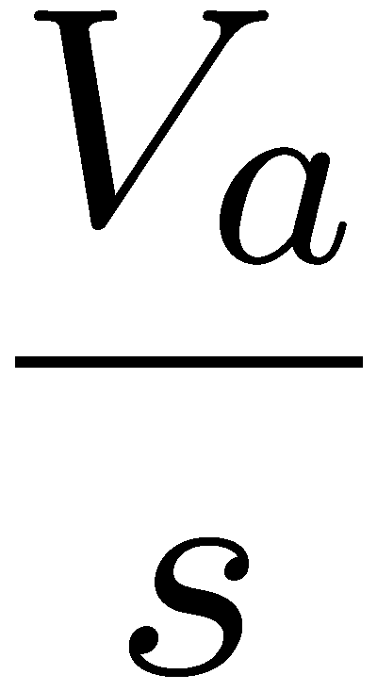
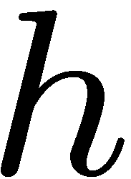
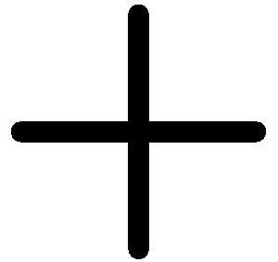
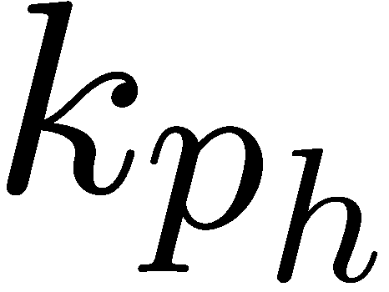
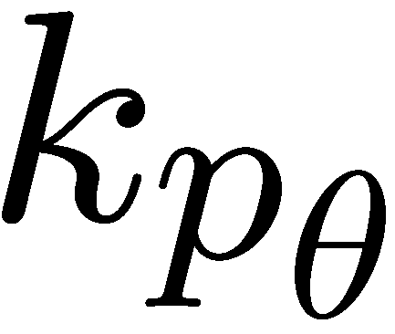

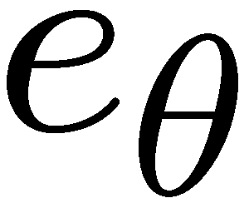
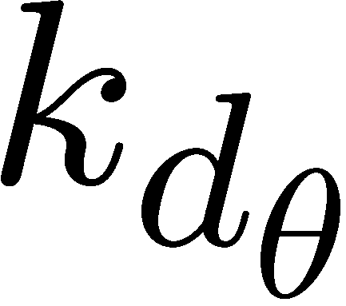
Altitude Hold Using Commanded Pitch
Notes:
\noindent
Provided pitch loop functions as intended, we can simplify the
inner-loop dynamics to $\theta^c/\theta \approx K_{\theta_\text{DC}}$

Slide 19
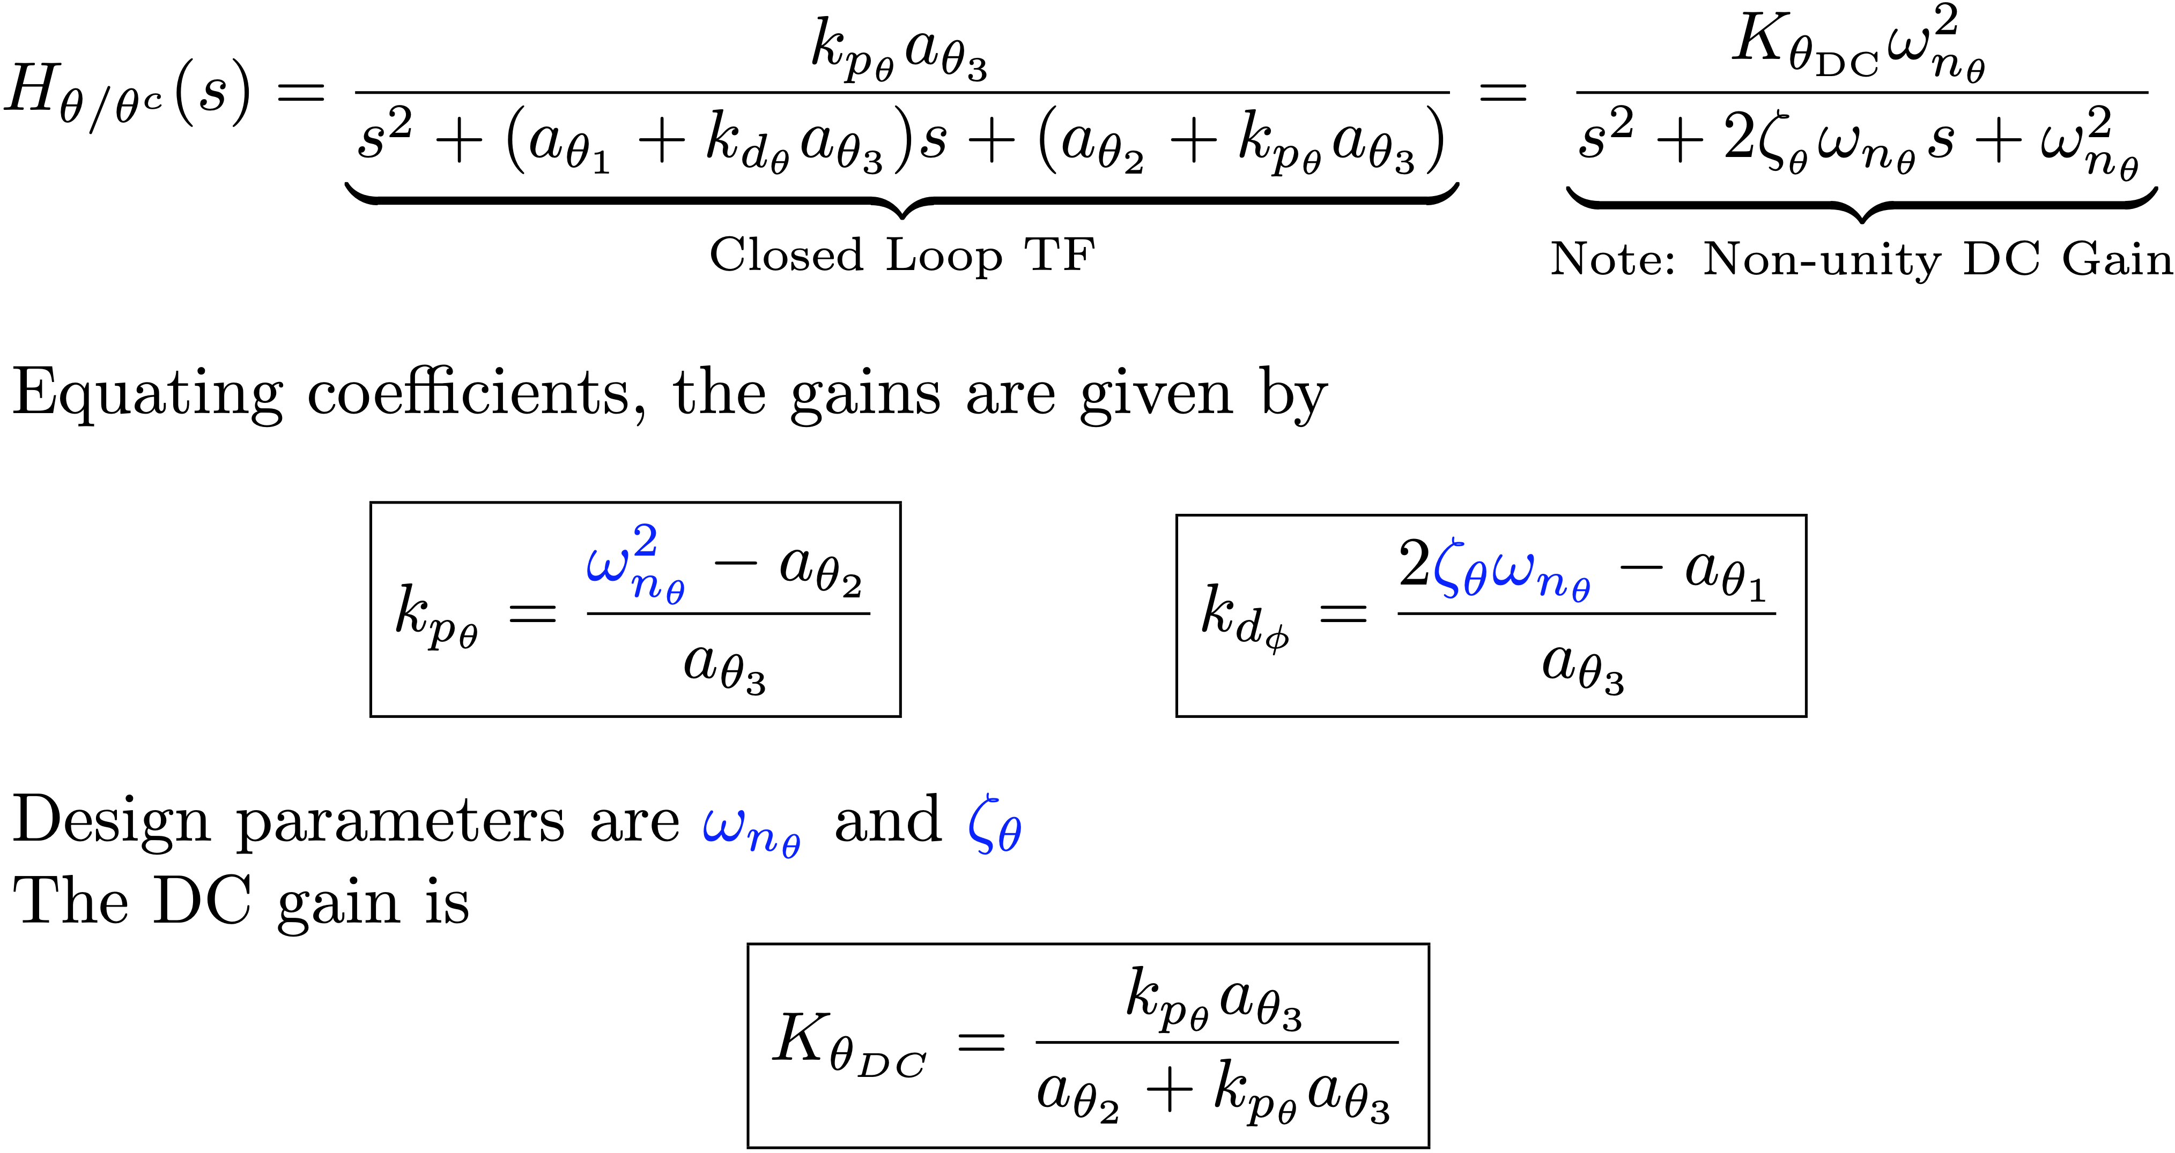
Pitch Attitude Hold
Notes:
\[
H_{\theta/\theta^c}(s) = \underbrace{\frac{k_{p_{\theta}}a_{\theta_3}}{s^2 +
(a_{\theta_1} + k_{d_{\theta}}a_{\theta_3})s +
(a_{\theta_2}+k_{p_{\theta}}a_{\theta_3})}}_{\text{Closed Loop TF}}
= \underbrace{\frac{K_{\theta_\text{DC}} \omega_{n_\theta}^2}{s^2 +
2\zeta_{_\theta}\omega_{n_\theta} s + \omega_{n_\theta}^2}}_{\text{Note: Non-unity DC Gain}}
\]
Equating coefficients, the gains are given by
\[
\boxed{k_{p_\theta} = \frac{{\color{blue}\omega_{n_\theta}^2}-a_{\theta_2}}{a_{\theta_3}}} \qquad \qquad
\boxed{k_{d_{\phi}} = \frac{2{\color{blue}\zeta_{\theta}}{\color{blue}\omega_{n_\theta}}-a_{\theta_1}}{a_{\theta_3}}}
\]
Design parameters are {\color{blue}$\omega_{n_\theta}$} and {\color{blue}$\zeta_{\theta}$}
The DC gain is
\[
\boxed{K_{\theta_{DC}}=\frac{k_{p_\theta}a_{\theta_3}}{a_{\theta_2}+ k_{p_\theta}a_{\theta_3}}}
\]

Slide 20

Altitude Hold Using Commanded Pitch
Notes:
\noindent
Provided pitch loop functions as intended, we can simplify the
inner-loop \\ dynamics to $\theta \approx K_{\theta_\text{DC}} \theta^c$

Slide 21
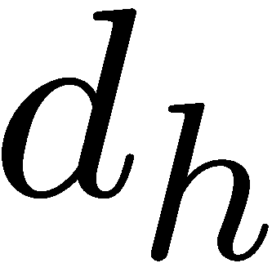
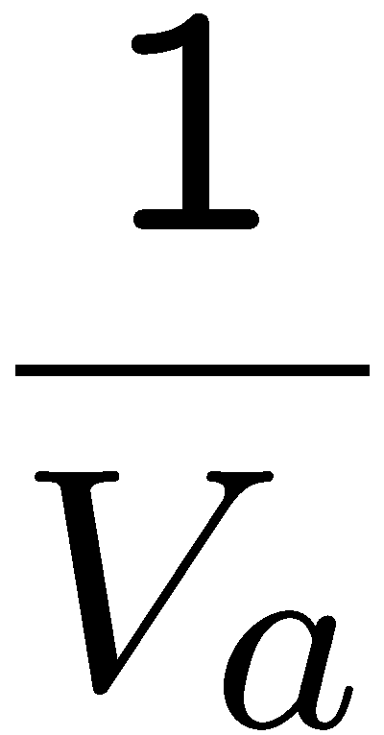


Altitude from Pitch – Simplified
Notes:
\noindent
\[
h(s) =
\left(\frac{K_{\theta_\text{DC}}V_ak_{p_h}s+K_{\theta_\text{DC}}V_a k_{i_h}}{s^2
+ K_{\theta_\text{DC}}V_a k_{p_h}s + K_{\theta_\text{DC}}V_a
k_{i_h}}\right) h^c(s) + \left(\frac{s}{s^2 +
K_{\theta_\text{DC}}V_a k_{p_h}s + K_{\theta_\text{DC}}V_a
k_{i_h}}\right) d_h(s)
\]
\noindent
A PI control on altitude ensures that $h$ tracks constant $h^c$ with zero steady-state error and rejects constant disturbances

Slide 22
Altitude from Pitch Gain Calculations
Notes:
\noindent
Equating the transfer functions
\[
H_{h/h^c}(s)=
\frac{K_{\theta_\text{DC}}V_ak_{p_h}s+K_{\theta_\text{DC}}V_ak_{i_h}}{s^2
+ K_{\theta_\text{DC}}V_a k_{p_h}s + K_{\theta_\text{DC}}V_a
k_{i_h}} \quad \text{and} \quad H_c(s) = \frac{2\zeta \omega_{n} s +
\omega_{n}^2}{s^2 + 2\zeta\omega_{n} s +
\omega_{n}^2}
\]
gives the coefficients
\[
\boxed{k_{i_{h}} = \frac{\omega_{n_h}^2}{K_{\theta_\text{DC}}V_a}} \qquad \qquad
\boxed{k_{p_{h}} = \frac{2{\color{blue}\zeta_{h}}\omega_{n_h}}{K_{\theta_\text{DC}}V_a}}
\]
where bandwidth separation is achieved by selecting
\[
\omega_{n_h} = \frac{1}{{\color{blue}W_h}}\omega_{n_{\theta}}
\]
\noindent
Design parameters are bandwidth separation {\color{blue}$W_h$} and damping ratio {\color{blue}$\zeta_{\theta}$}

Slide 23
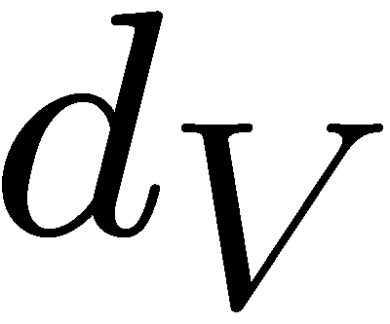
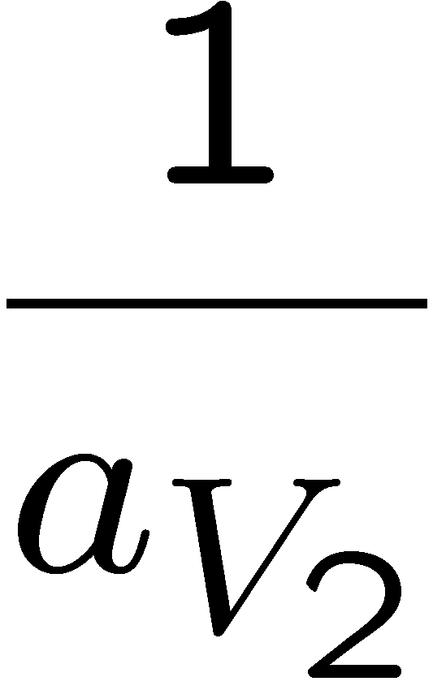
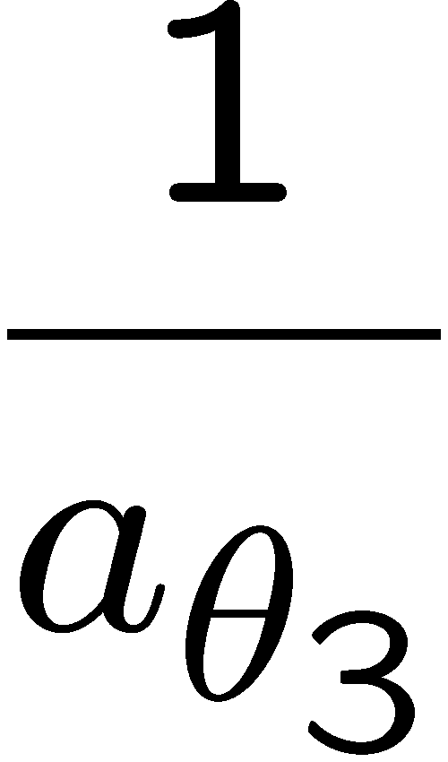
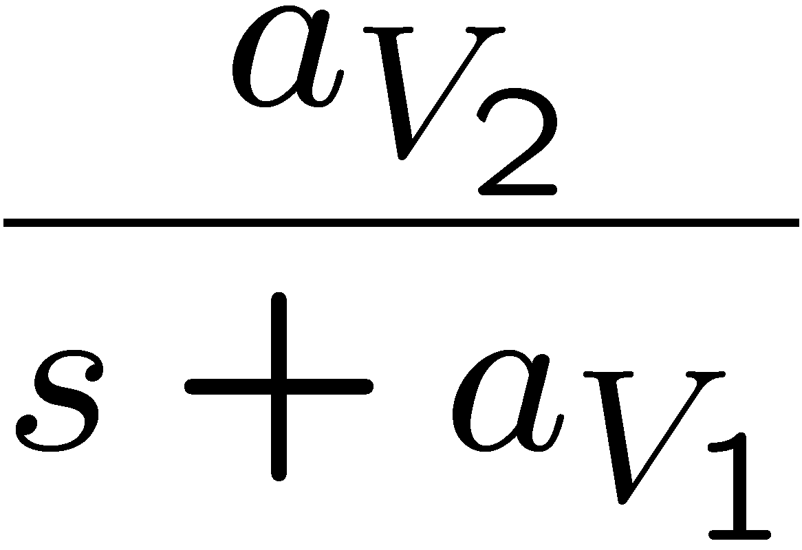
Airspeed Hold Using Throttle
Notes:
\[
V_a =
\left(\frac{a_{V_2}(k_{p_V}s+k_{i_V})}{s^2+(a_{V_1}+a_{V_2}k_{p_V})s
+ a_{V_2}k_{i_V}} \right)V_a^c +
\left(\frac{s}{s^2+(a_{V_1}+a_{V_2}k_{p_V})s + a_{V_2}k_{i_V}}
\right) d_V
\]
\vspace{0.1in}
\noindent
A PI control on the throttle-to-airspeed loop ensures that $V_a$ tracks a constant $V_a^c$ with zero steady-state error and rejects constant disturbances

Slide 24
Airspeed from Throttle Gain Calculations
Notes:
\noindent
Equating the transfer functions and their coefficients
\[
H_{V_a/V_a^c}(s) = \left(\frac{a_{V_2}k_{p_V}s+a_{V_2}k_{i_V}}{s^2+(a_{V_1}+a_{V_2}k_{p_V})s
+ a_{V_2}k_{i_V}} \right)
= \frac{\varrho 2\zeta \omega_{n} s +
\omega_{n}^2}{s^2 + 2\zeta\omega_{n} s +
\omega_{n}^2}
\]
gives the gains
\[
\boxed{k_{i_{V}} = \frac{{\color{blue}\omega_{n_{V}}}^2}{a_{V_2}}} \qquad \qquad
\boxed{k_{p_{V}} = \frac{2{\color{blue}\zeta_{V}}{\color{blue}\omega_{n_{V}}}-a_{V_1}}{a_{V_2}}}
\]
\vspace{0.1in}
\noindent Design parameters are natural frequency {\color{blue}$\omega_{n_V}$} and damping ratio {\color{blue}$\zeta_{V}$}
\vspace{0.1in}
\noindent The control signal is
\begin{align*}
\delta_t &= \delta_t^{\ast} + \bar{\delta}_t \\
&= \delta_t^{\ast} + k_{p_{V}} (V_a^c-V_a) + k_{i_{V}} \int (V_a^c-V_a) dt
\end{align*}
Note that if $\delta_t^\ast$ is imprecisely known, the integrator will compenstate.

Slide 25
Python Implementation
Notes:
\begin{lstlisting}[language=Python]
class autopilot:
def __init__(self, ts_control):
self.roll_from_aileron = pdControlWithRate(kp, kd, limit)
self.course_from_roll = piControl(kp, ki, Ts, limit)
self.yaw_damper = transferFunction(num, den, Ts)
self.pitch_from_elevator = pdControlWithRate(kp, kd, limit)
self.altitude_from_pitch = piControl(kp, ki, Ts, limit)
self.airspeed_from_throttle = piControl(kp, ki, Ts, limit)
def update(self, cmd, state):
# lateral autopilot
chi_c = wrap(cmd.course_command, state.chi)
phi_c = self.saturate(
cmd.phi_feedforward + self.course_from_roll.update(chi_c, state.chi),
-np.radians(30), np.radians(30))
delta_a = self.roll_from_aileron.update(phi_c, state.phi, state.p)
delta_r = self.yaw_damper.update(state.r)
# longitudinal autopilot
# saturate the altitude command
h_c = self.saturate(cmd.altitude_command,
state.h - AP.altitude_zone, state.h + AP.altitude_zone)
theta_c = self.altitude_from_pitch.update(h_c, state.h)
delta_e = self.pitch_from_elevator.update(theta_c, state.theta, state.q)
delta_t = self.airspeed_from_throttle.update(cmd.airspeed_command,
state.Va)
delta_t = self.saturate(delta_t, 0.0, 1.0)
return delta, self.commanded_state
\end{lstlisting}

Slide 26
Wrap Function
Notes:
\begin{lstlisting}[language=Python]
import numpy as np
def wrap(chi_1, chi_2):
while chi_1 - chi_2 > np.pi:
chi_1 = chi_1 - 2.0 * np.pi
while chi_1 - chi_2 < -np.pi:
chi_1 = chi_1 + 2.0 * np.pi
return chi_1
\end{lstlisting}

Slide 27
Longitudinal Autopilot - Summary
Notes:
If model is known, the the design parameters are
\par\noindent{\bf Inner Loop (pitch attitude hold)}
\begin{itemize}
\item ${\color{blue}\omega_{n_\theta}}$ - natural frequency for pitch.
\item ${\color{blue}\zeta_{\theta}}$ - Damping ratio for pitch attitude loop.
\end{itemize}
\par\noindent{\bf Altitude Hold Outer Loop }
\begin{itemize}
\item ${\color{blue}W_h>1}$ - Bandwidth separation between pitch and altitude loops.
\item ${\color{blue}\zeta_{h}}$ - Damping ratio for altitude hold loop.
\end{itemize}
\par\noindent{\bf Airspeed Hold Outer Loop }
\begin{itemize}
\item ${\color{blue}W_{V_2}>1}$ - Bandwidth separation between pitch and airspeed loops.
\item ${\color{blue}\zeta_{V_2}}$ - Damping ratio for airspeed hold loop.
\end{itemize}
\par\noindent{\bf Throttle hold (inner loop)}
\begin{itemize}
\item ${\color{blue}\omega_{n_V}}$ - Natural frequency for throttle loop.
\item ${\color{blue}\zeta_{V}}$ - Damping ratio for throttle loop.
\end{itemize}

Slide 28
Longitudinal Autopilot – In Flight Tuning

Slide 29
PID Loop Implementation
PID continuous time
Taking Laplace transform…
Use bandwidth-limited differentiator to reduce noise

Slide 30
PID Loop Implementation
Tustin’s rule or trapezoidal rule
Integrator term
Differentiator term

Slide 31
Integrator Anti-wind-up
control before anti-wind-up update
control after anti-wind-up update
is anti-wind-up update
subtracting top two equations
Let
value of control after saturation is applied
solving…

Slide 32
PID Implementation (Python)

Slide 33
PID Implementation (Matlab)

Slide 34
Yaw Damper Implementation
Notes:
\noindent
For a general, first-order continuous-time transfer function of the form
\[
H(s) = \frac{U(s)}{Y(s)} = k \left(\frac{n_1 s + n_0}{d_1 s + d_0}\right)
\]
we want to be able to calculated the equivalent discrete-time transfer function
\[
H(z) = \frac{U(z)}{Y(z)} = \frac{b_0 + b_1 z^{-1}}{1 + a_1 z^{-1}}
\]
for a specific sample rate $T_s$. Using Tustin's method (trapezoidal rule) by \\ substituting
$s \rightarrow \frac{2}{T_s}\left(\frac{1-z^{-1}}{1+z^{-1}}\right)$, we can calculate the coefficients of $H(z)$ as
\begin{align*}
b_0 = \frac{k (2 n_1 + T_s n_0)}{2 d_1 + T_s d_0} \qquad b_1 &= -\frac{k (2 n_1 - T_s n_0)}{2 d_1 + T_s d_0} \\
a_1 &= -\frac{k (2 d_1 - T_s d_0)}{2 d_1 + T_s d_0}
\end{align*}
By taking the inverse $z$ transform, we can convert our discrete transfer function to an discrete-time difference equation:
\[
u_k = -a_1 u_{k-1} + b_0 y_k + b_1 y_{k-1}
\]

Slide 35
Yaw Damper Implementation
Notes:
\noindent
For our yaw damper,
\[
H(s) = \frac{\delta_r(s)}{r(s)} = k_r \left(\frac{s}{\tau_r s + 1}\right) = k_r \left(\frac{s}{s+p_{wo}}\right),
\]
where $k_r = 0.2$, $p_{wo} = 0.45$ rad/s, and $T_s = 0.01$ s
\vspace{0.1in}
\noindent
This gives a discrete-time transfer function of
\[
H(z) = \frac{\delta_r(z)}{r(z)} = \frac{0.1996 - 0.1996 \, z^{-1}}{1 - 0.9955 \, z^{-1}}
\]
with the corresponding difference equation
\[
\delta_{r,k} = 0.9955 \, \delta_{r,k-1} + 0.1996 \, r_k - 0.1996 \, r_{k-1}
\]
The coeficients of $H(z)$ can be calculated manually as we have done here or they can be computed in MATLAB using the \texttt{c2d} command with the \texttt {'tustin'} option or in Python using the \texttt{control.matlab.c2d} function. This is especially convenient for higher-order transfer functions.

Slide 36
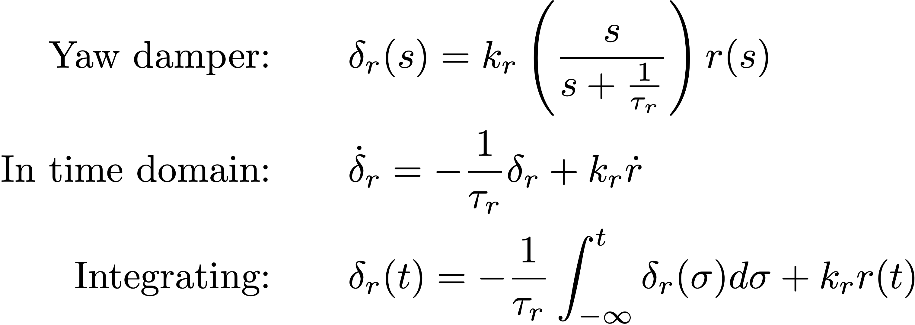
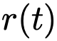
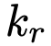
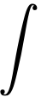
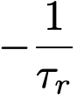
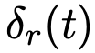
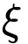
Yaw Damper Implementation
Notes:
\begin{align*}
\text{Yaw damper:} &\qquad \delta_r(s) = k_r\left(\frac{s}{s+\frac{1}{\tau_r}}\right) r(s) \\
\text{In time domain:} &\qquad \dot{\delta}_r = -\frac{1}{\tau_r}\delta_r + k_r \dot{r} \\
\text{Integrating:} &\qquad \delta_r(t) = -\frac{1}{\tau_r}\int_{-\infty}^t \delta_r(\sigma)d\sigma + k_r r(t)
\end{align*}
--
State-space form:
\begin{align*}
\dot{\xi} &= -\frac{1}{\tau_r} \xi + k_r r \\
\delta_r &= -\frac{1}{\tau_r} \xi + k_r r.
\end{align*}
--
Discrete-time:
\begin{align*}
\xi_k &= -\frac{1}{\tau_r} \xi_{k-1} + k_r r_{k-1} \\
\delta_{rk} &= -\frac{1}{\tau_r} \xi_k + k_r r_k.
\end{align*}

Slide 37
Yaw Damper Implementation Alternative
Notes:
\begin{lstlisting}[language=Python]
class yawDamper:
def __init__(self, k_r, tau_r, Ts):
# set initial conditions
self.xi = 0.
self.Ts = Ts
self.k_r = k_r
self.tau_r = tau_r
def update(self, u):
self.xi = self.xi
+ self.Ts * (-1/self.tau_r * self.xi + self.k_r * r)
delta_r = -1/self.tau_r * self.xi + self.k_r * r
return delta_r
\end{lstlisting}

Slide 38
Simulation Project
Notes:
\begin{description}
\item[Step 1.] Roll attitude loop. For Aerosonde model use $V_a=25~m/s$. Put aircraft in trim, and tune step response on roll.
\item[Step 2.] Tune the yaw damper to keep $\beta\approx 0$.
\item[Step 3.] Course attitude loop. Tune step response in $\chi$.
\item[Step 4.] Pitch attitude loop. Tune step response in in pitch angle.
\item[Step 5.] Tune step response in airspeed.
\item[Step 6.] Tune step response in altitude (after saturation).
\item[Step 7.] Stress test simulation from take-off. Command steps in alititude, airspeed, course.
\end{description}

Slide 39
Outline
Successive Loop Closure
Total Energy Control
LQR Control

Slide 40
Total Energy Control
Notes:
\begin{itemize}
\item Developed in the 1980's by Antonius Lambregts
\item Based on energy manipulation techniques from the 1950's
\item Control the energy of the system instead of the altitude and airspeed
\end{itemize}

Slide 41
Total Energy Control
Notes:
\begin{itemize}
\item{Kinetic Energy}: $\qquad E_K \triangleq \frac{1}{2} m V_a^2$
\item{Potential Energy}: $\qquad E_P \triangleq m g h$
\vspace{2mm}
\item{Total Energy}: $\qquad E_T \triangleq E_P + E_K$
\item{Energy Difference}: $\qquad E_D \triangleq E_P - E_K$
\end{itemize}

Slide 42
Total Energy Control
Notes:
Original TECS proposed by Lambregts is based on energy rates:
\begin{itemize}
\item $T^c = T_D + k_{p,t} \dot{E}_t + k_{i,t} \int_{t_0}^t \dot{\tilde{E}}_t \delta_\tau$
\begin{itemize}
\item $T_D$ is thrust needed to counteract drag
\item PI controller based on total energy rate
\end{itemize}
\vspace{2mm}
\item $\theta^c = k_{p,\theta} \dot{E}_d + k_{i,\theta} \int_{t_0}^t \dot{\tilde{E}}_d \delta_\tau$
\begin{itemize}
\item PI controller based on energy distribution rate
\end{itemize}
\vspace{2mm}
\item Stability shown for linear systems
\end{itemize}
{\color{blue} We will show that the performance of this scheme is less than desirable.}

Slide 43
Total Energy Control
Notes:
If the trust needed to counteract drag is unknown, then one possibility is to use an integrator to find $T_D$:
\begin{itemize}
\item $T^c = k_{p,t} \tilde{E}_t + k_{i,t} \int \tilde{E}_t d\tau + k_{d,t} \dot{E}_t $
\begin{itemize}
\item PID controller based on total energy (not energy rate)
\end{itemize}
\vspace{2mm}
\item $\theta^c = k_{p,\theta} \tilde{E}_d + k_{i,\theta} \int \tilde{E}_d d\tau + k_{d,\theta}\dot{E}_d$
\begin{itemize}
\item PID controller based on energy distribution (not rate)
\end{itemize}
\end{itemize}

Slide 44
Total Energy Control
Notes:
Nonlinear re-derivation:
\begin{itemize}
\item Error Definitions
\begin{align*}
\tilde{E}_K &= \frac{1}{2}m \left( \left(V^d_a\right)^2 - V_a^2 \right) \\
\tilde{E}_P &= m g \left( h^d - h \right)
\end{align*}
\item Lyapunov Function
\begin{equation*}
V = \frac{1}{2} \tilde{E}_T^2 + \frac{1}{2} \tilde{E}_D^2
\end{equation*}
\item Controller
\begin{align*}
T^c &= D + \frac{\tilde{E}^d_T}{V_a} + k_T \frac{\tilde{E}_T}{V_a} \\
\gamma^c &= \sin^{-1}\left(\dfrac{\dot{h}^d}{V_a} + \dfrac{1}{2 m g V_a} \left( -k_1 \tilde{E}_K + k_2 \tilde{E}_P \right)\right) \\
\end{align*}
\end{itemize}

Slide 45
Total Energy Control
Notes:
\begin{itemize}
\item{Original:} $\qquad T^c = D + k_{p,t} \dfrac{\dot{E}_T}{m g V_a} + k_{i,t} \dfrac{\tilde{E}_T}{m g V_a}$
\item{Nonlinear:} $\qquad T^c = D + \dfrac{\dot{E}^d_T}{V_a} + k_T \dfrac{\tilde{E}_T}{V_a}$
\end{itemize}
\vspace{10mm}
Similar if $ k_{p,T} = m g$ and $k_{i,T} = m g k_T$.
\vspace{1cm}
The nonlinear controller uses the desired energy rate.

Slide 46
Total Energy Control
Notes:
\begin{itemize}
\item{Modified Original (Ardupilot):}
\begin{align*}
\qquad \theta^c &= \dfrac{k_{p,\theta}}{V_a m g} \left( \left( 2-k \right) \dot{E}_P - k \dot{E}_K \right) + \dfrac{k_{i,\theta}}{V_a m g} \tilde{E}_D \\
k &\in [0, 2 ]
\end{align*}
\item{Nonlinear:}
\begin{align*}
\qquad \gamma^c &= \sin^{-1}\left( \dfrac{\dot{h}^d}{V_a} + \dfrac{1}{2 m g V_a} \left( -k_1 \tilde{E}_K + k_2 \tilde{E}_P \right)\right)
\\
k_1 &\triangleq |k_T - k_D| \\
k_2 &\triangleq k_T + k_D \\
0 &< k_T \leq k_D
\end{align*}
\end{itemize}
Lyapunov derivation suggests potential energy error should be weighted more than kinetic energy

Slide 47
Total Energy Control
Notes:
If the drag is unknown, then we can add an adaptive estimate:
\begin{align*}
T^c &= \hat{D} + \boldsymbol{\Phi}^\top \hat{\boldsymbol{\Psi}} + \frac{\dot{E}^d_T}{V_a} + k_T \frac{\tilde{E}_T}{V_a} \\
\gamma^c &= \sin^{-1}\left(\dfrac{\dot{h}^d}{V_a} + \dfrac{1}{2 m g V_a} \left( -k_1 \tilde{E}_K + k_2 \tilde{E}_P \right)\right) \\
\dot{\hat{\boldsymbol{\Psi}}} &= \left(\Gamma_T \tilde{E}_T - \Gamma_D \tilde{E}_D\right) \boldsymbol{\Phi} V_a
\end{align*}

Slide 48
Total Energy Control
Step in Altitude, Constant Airspeed

Slide 49
Total Energy Control
Step in Airspeed, Constant Altitude

Slide 50
Total Energy Control
Step in Altitude and Airspeed

Slide 51
Total Energy Control
Observations
TECS seems to work better than successive loop closure.
Removes needs for different flight modes.
Nonlinear TECS seems to better, but the Ardupilot controller works very well.

Slide 52
Outline
Successive Loop Closure
Total Energy Control
LQR Control

Slide 53
LQR Control
Notes:
\par\noindent{\bf Augment the States with an Integrator.}
Given the state space system
\begin{align*}
\dot{x} &= Ax + Bu \\
z &= Hx
\end{align*}
where $z$ represents the controlled output. Suppose that the objective is to drive $z$ to a reference signal $z_r$. Augment the state with the integrator
\[
x_I = \int_{-\infty}^t \left(z(\tau)-z_r\right)d\tau.
\]
Therefore
\[
\dot{x}_I = Hx - z_r = H(x-x_r)
\]

Slide 54
LQR Control
Notes:
\par\noindent{\bf Augment the States with an Integrator. (cont)}
Defining the augmented state as $\xi = (x^\top, x_I^\top)^\top$, results in the augmented state space equations
\[
\dot{\xi} = \bar{A}\xi + \bar{B}u,
\]
where
\[
\bar{A} = \begin{pmatrix} A & 0 \\ H & 0 \end{pmatrix} \qquad \qquad
\bar{B} = \begin{pmatrix} B \\ 0 \end{pmatrix}.
\]

Slide 55
LQR Control
Notes:
\par\noindent{\bf Linear Quadratic Regulator Theory}
Given the state space equation
\[
\dot{x} = Ax + Bu
\]
and the symmetric positive semi-definite matrix $Q$, and the symmetric positive definite matrix $R$, the LQR problem is to minimize the cost index
\[
J(x_0) = \min_{u(t)} \int_0^\infty x^\top(\tau) Q x(\tau) + u^\top(\tau) R u(\tau) d\tau.
\]
If $(A,B)$ is controllable, and $(A,Q^{1/2})$ is observable, then a unique optimal control exists and is given in linear feedback form as
\[
u^\ast(t) = -K_{lqr} x(t).
\]

Slide 56
LQR Control
Notes:
\par\noindent{\bf Linear Quadratic Regulator Theory (cont) }
The LQR gain is given by
\[
K_{lqr} = R^{-1}B^\top P,
\]
where $P$ is the symmetric positive definite solution of the Algebraic Riccati Equation
\[
PA + A^\top P + Q - PBR^{-1}B^\top P = 0.
\]

Slide 57
LQR Control
Notes:
\par\noindent{\bf Linear Quadratic Regulator Theory (cont) }
It should be noted that $K_{lqr}$ is the optimal feedback gains given $Q$ and $R$. The controller is tuned by changing $Q$ and $R$.
Typically we choose $Q$ and $R$ to be diagonal matrices
\[
Q = \begin{pmatrix} q_1 & 0 & \dots & 0 \\ 0 & q_2 & \dots & 0 \\ \vdots & & \ddots & \vdots \\ 0 & 0 & \dots & q_n \end{pmatrix} \qquad \qquad R = \begin{pmatrix} r_1 & 0 & \dots & 0 \\ 0 & r_2 & \dots & 0 \\ \vdots & & \ddots & \vdots \\ 0 & 0 & \dots & r_m \end{pmatrix},
\]
where $n$ is the number of states, $m$ is the number of inputs, and $q_i\geq 0$ ensures $Q$ is positive semi-definite, and $r_i>0$ ensure $R$ is positive definite.

Slide 58
LQR Control
Notes:
\par\noindent{\bf Lateral Autopilot }
As derived in Chapter 5, the state space equations for the lateral equation of motion are given by
\[
\dot{x}_{lat} = A_{lat}x_{lat} + B_{lat} u_{lat},
\]
where $x_{lat} = (v, p, r, \phi, \psi)^\top$ and $u_{lat} = (\delta_a, \delta_r)^\top$.
The objective of the lateral autopilot is to drive course $\chi$ to commanded course $\chi_c$. Therefore, we augment the state with
\[
x_I = \int (\chi-\chi_c) dt.
\]
Since $\chi\approx \psi$, we approximate $x_I$ as
\[
x_I = \int (H_{lat}x_{lat}-\chi_c) dt,
\]
where $H_{lat}=(0, 0, 0, 0, 1)$.

Slide 59
LQR Control
Notes:
\par\noindent{\bf Lateral Autopilot (cont) }
The augmented lateral state equations are therefore
\[
\dot{\xi}_{lat} = \bar{A}_{lat} \xi_{lat} + \bar{B}_{lat} u_{lat},
\]
where
\[
\xi_{lat} = (\tilde{v}, p, r, \phi, \tilde{\chi}, \int\tilde{\chi})^\top
\]
\[
\bar{A}_{lat} = \begin{pmatrix} A_{lat} & 0 \\ H_{lat} & 0 \end{pmatrix}
\qquad \qquad
\bar{B}_{lat} = \begin{pmatrix} B_{lat} \\ 0 \end{pmatrix}
\]
where
\[
\tilde{v} = (V_a - V_a^c) * \sin\beta, \qquad \tilde{\chi} = \chi-\chi^c
\]
The LQR controller designed using
\begin{align*}
Q &= \text{diag}\left(\left[q_v, q_p, q_r, q_\phi, q_\chi, q_{I} \right]\right) \\
R &= \text{diag}\left(\left[r_{\delta_a}, r_{\delta_r}\right]\right).
\end{align*}
Hints: Since the goal is to drive $\tilde{\chi}$ and $\int\tilde{\chi}$ to zero, it is best to place low weights on $v$, $p$, and $r$ relative to the other variables.

Slide 60
LQR Control
Notes:
\par\noindent{\bf Longitudinal Autopilot }
As derived in Chapter 5, the state space equations for the longitudinal equations of motion are given by
\[
\dot{x}_{lon} = A_{lon}x_{lon} + B_{lon} u_{lon},
\]
where $x_{lon} = (u, w, q, \theta, h)^\top$ and $u_{lat} = (\delta_e, \delta_t)^\top$.
The objective of the longitudinal autopilot is to drive altitude $h$ to commanded altitude $h^c$, and airspeed $V_a$ to commanded airspeed $V_a^c$. Therefore, we augment the state with
\begin{align*}
x_I &= \begin{pmatrix} \int (h-h^c) dt \\ \int (V_a-V_{a}^c) dt \end{pmatrix}
= \int \left( H_{lon}x_{lon} - \begin{pmatrix} h_c \\ V_{ac}\end{pmatrix} \right) dt.
\end{align*}
Therefore
\[
\dot{x}_I = H_{lon} x_{lon} - \begin{pmatrix} h^c \\ V_{a}^c\end{pmatrix}
= H_{lon} (x_{lon} - x^c)
\]
where
\[
H_{lon}=\begin{pmatrix} 0 & 0 & 0 & 0 & 1 \\ \frac{1}{V_a} & \frac{1}{V_a} & 0 & 0 & 0 \end{pmatrix}.
\]

Slide 61
LQR Control
Notes:
\par\noindent{\bf Longitudinal Autopilot (cont) }
The augmented longitudinal state equations are therefore
\[
\dot{\xi}_{lon} = \bar{A}_{lon} \xi_{lon} + \bar{B}_{lon} u_{lon},
\]
where
\[
\xi_{lon} = (\tilde{u}, \tilde{w}, q, \theta, \tilde{h}, \int\tilde{h}, \int\tilde{V}_a)^\top
\]
\[
\bar{A}_{lon} = \begin{pmatrix} A_{lon} & 0 \\ H_{lon} & 0 \end{pmatrix}
\qquad \qquad
\bar{B}_{lon} = \begin{pmatrix} B_{lon} \\ 0 \end{pmatrix}
\]
where
\[
\tilde{u} = (V_a-V_a^c)\cos\alpha, \qquad \tilde{w} = (V_a-V_a^c)\sin\alpha, \qquad \tilde{h}=h-h^c, \qquad \tilde{V}_a = V_a-V_a^c
\]
The LQR controller designed using
\begin{align*}
Q &= \text{diag}\left(\left[q_u, q_w, q_q, q_\theta, q_h, q_{Ih}, q_{IV_a} \right]\right) \\
R &= \text{diag}\left(\left[r_{\delta_e}, r_{\delta_t}\right]\right).
\end{align*}
Hints: Since $\theta$ need to be allowed to be non-zero, and since pitch rate does not necessarily need to be small, the weights $q_\theta$ and $q_q$ should be small.

Slide 62
Python Code
Notes:
\begin{lstlisting}
import sys
from numpy import array, sin, cos, radians, concatenate, zeros, diag
from scipy.linalg import solve_continuous_are, inv
sys.path.append('..')
import parameters.control_parameters as AP
#from tools.transfer_function import TransferFunction
from tools.wrap import wrap
import chap5.model_coef as M
from message_types.msg_state import MsgState
from message_types.msg_delta import MsgDelta
class Autopilot:
def __init__(self, ts_control):
self.Ts = ts_control
# initialize integrators and delay variables
self.integratorCourse = 0
self.integratorAltitude = 0
self.integratorAirspeed = 0
self.errorCourseD1 = 0
self.errorAltitudeD1 = 0
self.errorAirspeedD1 = 0
# compute LQR gains
CrLat = array([[0, 0, 0, 0, 1.0]])
AAlat = concatenate((
concatenate((M.A_lat, zeros((5,1))), axis=1),
concatenate((CrLat, zeros((1,1))), axis=1)),
axis=0)
BBlat = concatenate((M.B_lat, zeros((1,2))), axis=0)
Qlat = diag([.001, .01, .1, 100, 1, 100]) # v, p, r, phi, chi, intChi
Rlat = diag([1, 1]) # a, r
Plat = solve_continuous_are(AAlat, BBlat, Qlat, Rlat)
self.Klat = inv(Rlat) @ BBlat.T @ Plat
#CrLon = array([[0, 0, 0, 0, 1.0], [1.0, 0, 0, 0, 0]])
CrLon = array([[0, 0, 0, 0, 1.0], [1/AP.Va0, 1/AP.Va0, 0, 0, 0]])
AAlon = concatenate((
concatenate((M.A_lon, zeros((5,2))), axis=1),
concatenate((CrLon, zeros((2,2))), axis=1)),
axis=0)
BBlon = concatenate((M.B_lon, zeros((2,2))), axis=0)
Qlon = diag([10, 10, .001, .01, 10, 100, 100]) # u, w, q, theta, h, intH, intVa
Rlon = diag([1, 1]) # e, t
Plon = solve_continuous_are(AAlon, BBlon, Qlon, Rlon)
self.Klon = inv(Rlon) @ BBlon.T @ Plon
self.commanded_state = MsgState()
\end{lstlisting}

Slide 63
Python Code
Notes:
\begin{lstlisting}
def update(self, cmd, state):
# lateral autopilot
errorAirspeed = state.Va - cmd.airspeed_command
chi_c = wrap(cmd.course_command, state.chi)
errorCourse = saturate(state.chi - chi_c, -radians(15), radians(15))
self.integatorCourse = self.integratorCourse + (self.Ts/2) * (errorCourse + self.errorCourseD1)
self.errorCourseD1 = errorCourse
xLat = array([[errorAirspeed * sin(state.beta)], # v
[state.p],
[state.r],
[state.phi],
[errorCourse],
[self.integratorCourse]])
tmp = -self.Klat @ xLat
delta_a = saturate(tmp.item(0), -radians(30), radians(30))
delta_r = saturate(tmp.item(1), -radians(30), radians(30))
# longitudinal autopilot
altitude_c = saturate(cmd.altitude_command,
state.altitude - 0.2*AP.altitude_zone,
state.altitude + 0.2*AP.altitude_zone)
errorAltitude = state.altitude - altitude_c
self.integatorAltitude = self.integratorAltitude \
+ (self.Ts/2) * (errorAltitude + self.errorAltitudeD1)
self.errorAltitudeD1 = errorAltitude
self.integatorAirspeed = self.integratorAirspeed \
+ (self.Ts/2) * (errorAirspeed + self.errorAirspeedD1)
self.errorAirspeedD1 = errorAirspeed
xLon = array([[errorAirspeed * cos(state.alpha)], # u
[errorAirspeed * sin(state.alpha)], # w
[state.q],
[state.theta],
[errorAltitude],
[self.integratorAltitude],
[self.integratorAirspeed]])
tmp = -self.Klon @ xLon
delta_e = saturate(tmp.item(0), -radians(30), radians(30))
delta_t = saturate(tmp.item(1), 0.0, 1.0)
# construct control outputs and commanded states
delta = MsgDelta(elevator=delta_e,
aileron=delta_a,
rudder=delta_r,
throttle=delta_t)
self.commanded_state.altitude = cmd.altitude_command
self.commanded_state.Va = cmd.airspeed_command
self.commanded_state.phi = 0
self.commanded_state.theta = 0
self.commanded_state.chi = cmd.course_command
return delta, self.commanded_state
\end{lstlisting}

